Slide 1


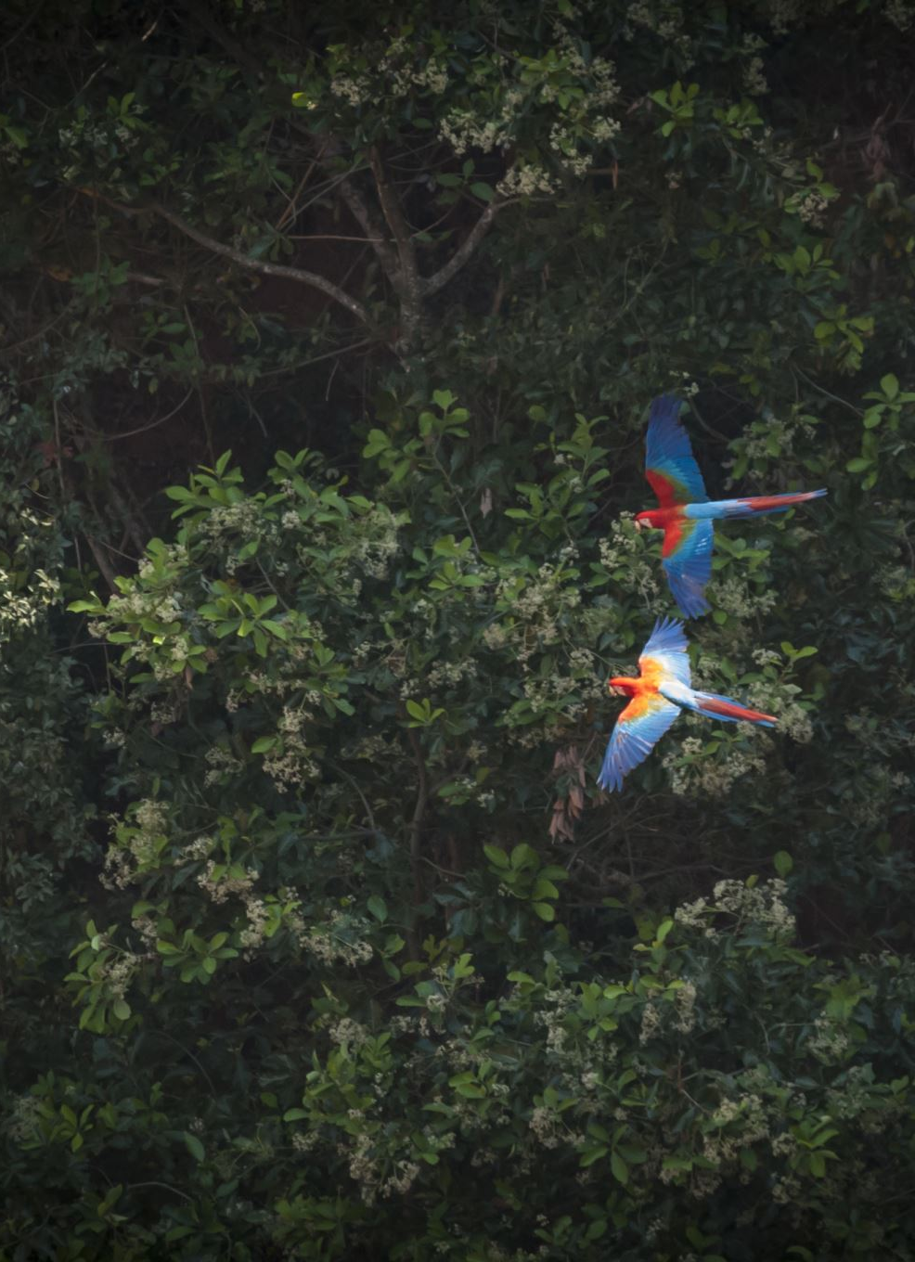



Wildlife Species Classification in Camera Trap Images: Taï National Park
Aseem Mishra
Marttin Emmanuel
Sagar Sheth

Slide 2
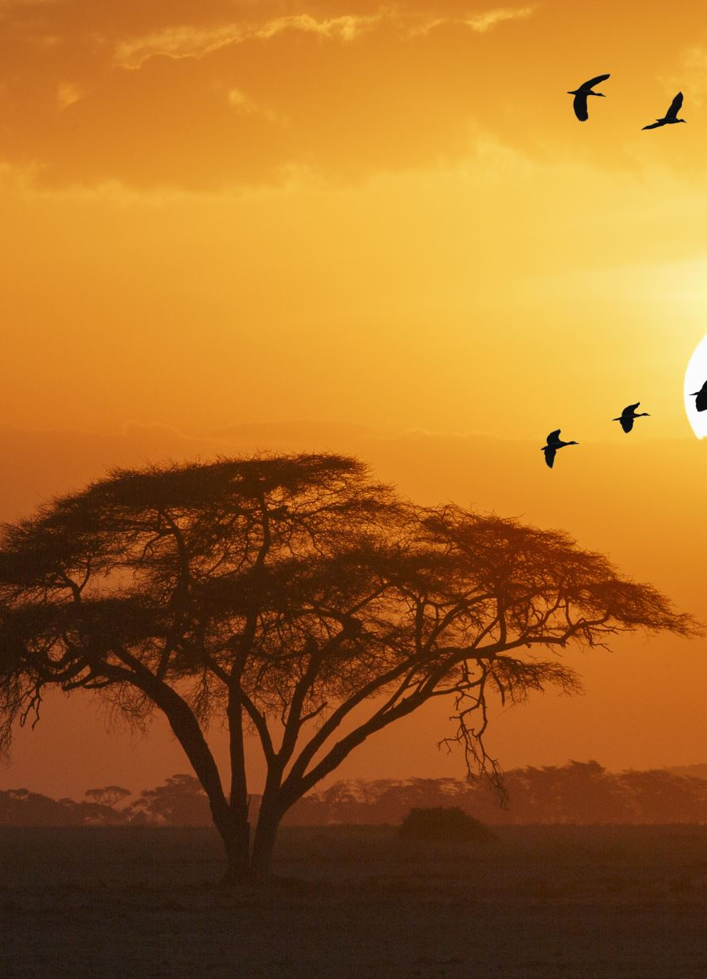
Introduction
The project is primarily motivated by the urgent need to enhance wildlife conservation and ecological research due to the imminent threats faced by Earth's biodiversity, including habitat loss, climate change, and human activities.
Through the development of an image classification model, we aim to support wildlife preservation and environmental stewardship by enabling the efficient monitoring and categorization of wildlife species, facilitating more informed conservation decisions.

Slide 3
Background
In the realm of wildlife conservation and ecological research, data collection is often a challenging and resource-intensive task.
Traditional methods for monitoring and tracking wildlife populations involve field surveys, camera traps, and manual observations, which are not only time-consuming but also labor-intensive.
However, with the advancements in machine learning and computer vision, it is now possible to leverage technology to automate this process to a large extent.
Our project focuses on the problem of image classification to identify seven specific species: birds, civets, duikers, hogs, leopards, other monkeys, and rodents. We are also addressing the issue of images that contain no animals.
The potential impact of this project extends to various areas, including the efficient management of protected areas, understanding species distribution and behavior, and aiding researchers in their studies.

Slide 4
Problem Statement
Our aim is to develop a model capable of classifying images into one of seven specified species categories or as containing no animals.
The Categories are :
Antelope Duiker
Civet Genet
Bird
Hog
Leopard
Monkey Prosimian
Rodent

Slide 5

The Dataset
The Dataset has been provided by drivendata.org.
It has over 16000 training images and 4000 test images.
Each image is .jpg file
Each image has been assigned its site, filepath and its label for training set.
The site is the location where the image was taken
The resolution of the image varies and is not fixed.
There is no overlap between sites in testing data and training data

Slide 6
Data Exploration
Data Description

Slide 7
Data Exploration

Slide 8
Baseline Approach
Convert images to a specific resolution (224x224)
Convert these images into matrix
Split our data into training, validation and test set
Select appropriate model to categorize like convolutional neural network (CNN)
Train the model and check for accuracy
Once training is done, generate predictions for validation set and modify parameters if there is overfitting or underfitting
Once all Modifications are done, run our model over test set to get final accuracy

Slide 9
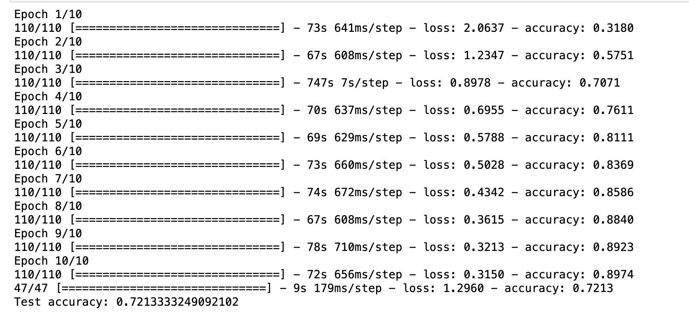
Preliminary Test Results
Accuracy of 72% on validation set and 89.7% on Training set indicating variance over following Neural net configuration:
2 Convolution layer with 32 filter and 64 filters respectively
2 Max pooling layers each after a convolution layer
1 Flatten Layer
2 Dense layers with 128 neurons and 8 neurons respectively

Slide 10
Final Approach
Convert images to a specific resolution (224x224)
Convert these images into cv2 matrix
Split our data into training, validation and test set
Train the Data on the below 3 Models
1. 2 CNN Layers and 1 Dense Layer.
2. 2 CNN Layers and 2 Dense Layers.
3. Using Transfer learning from Image net.
Evaluate accuracy of each model and choose the best approach
After choosing the best model, generate predictions for validation set and modify parameters if there is overfitting or underfitting
Once all Modifications are done, run our model over test set to get final accuracy

Slide 11
Model 1
1st Input Convolution layer uses a 3x3 filter matrix for pattern recognition to obtain an activation map. This layer contains 32 Neurons.
The output of this is used as input to a 2x2 Pooling layer to reduce the spacial size of the input.
2nd Convolution Layer uses a 3x3 filter matrix who’s functionality is the same as the 1st Convolution layer. This layer contains 64 Neurons.
Similar as above 2x2 Pooling layer is used.
We use a flattening layer to convert the data into a 1D array.
This 1D array is then sent to a Dense Layer with 128 Neurons with “Relu” as activation function.
Final Output layer is a Dense Layer with 8 Neurons and “Softmax” activation.

Slide 12
Model 1 Training Performance
Epoch | loss | Train Accuracy | val_loss | val_accuracy
1/10 | 1.6485 | 0.4776 | 1.0136 | 0.6533
2/10 | 0.8253 | 0.7172 | 0.7521 | 0.7533
3/10 | 0.5804 | 0.8067 | 0.7077 | 0.7659
4/10 | 0.4464 | 0.8516 | 0.5932 | 0.8148
5/10 | 0.3589 | 0.879 | 0.5986 | 0.8278
6/10 | 0.2985 | 0.9022 | 0.67 | 0.8226
7/10 | 0.2571 | 0.9136 | 0.5778 | 0.8481
8/10 | 0.2184 | 0.93 | 0.6611 | 0.8433
9/10 | 0.2042 | 0.9331 | 0.5969 | 0.8478
10/10 | 0.1775 | 0.9462 | 0.5841 | 0.8552

Slide 13
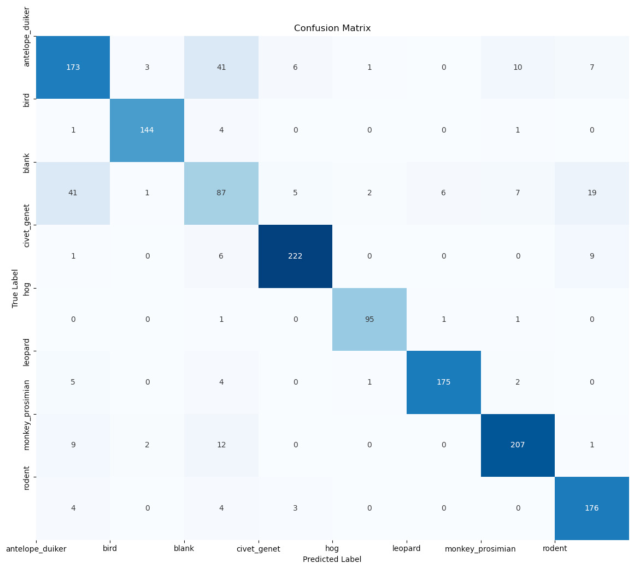
Model 1 Confusion Matrix (Holdout Set)

Slide 14
Model 1 Evaluation (Holdout Set)
 | precision | recall | f1-score | support
antelope_duiker | 0.74 | 0.72 | 0.73 | 241
bird | 0.96 | 0.96 | 0.96 | 150
blank | 0.55 | 0.52 | 0.53 | 168
civet_genet | 0.94 | 0.93 | 0.94 | 238
hog | 0.96 | 0.97 | 0.96 | 98
leopard | 0.96 | 0.94 | 0.95 | 187
monkey_prosimian | 0.91 | 0.9 | 0.9 | 231
rodent | 0.83 | 0.94 | 0.88 | 187
accuracy |  |  | 0.85 | 1500
macro avg | 0.86 | 0.86 | 0.86 | 1500
weighted avg | 0.85 | 0.85 | 0.85 | 1500

Slide 15
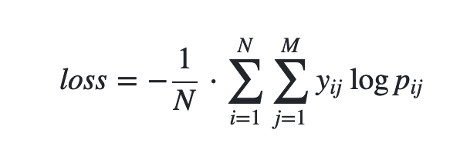
Model 1 Evaluation Metric (Holdout set) As per Competition
Log Loss: 5.310431599329929

Slide 16
Model 2
1st Input Convolution layer uses a 4x4 filter matrix for pattern recognition to obtain an activation map. This layer contains 32 Neurons.
The output of this is used as input to a 2x2 Pooling layer to reduce the spacial size of the input.
2nd Convolution Layer uses a 4x4 filter matrix who’s functionality is the same as the 1st Convolution layer. This layer contains 64 Neurons.
Similar as above 2x2 Pooling layer is used.
We use a flattening layer to convert the data into a 1D array.
This 1D array is then sent to a Dense Layer with 128 Neurons with “Relu” as activation function.
Another Layer with 128 Neurons with “Relu” as activation function..
Final Output layer is a Dense Layer with 8 Neurons and “Softmax” activation.

Slide 17
Model 2 Training Performance
Epoch | loss | Train Accuracy | val_loss | val_accuracy
1/10 | 1.4448 | 0.467 | 1.0601 | 0.6341
2/10 | 0.8382 | 0.7059 | 0.7758 | 0.7478
3/10 | 0.5618 | 0.8055 | 0.6781 | 0.7696
4/10 | 0.4719 | 0.8381 | 0.6456 | 0.7937
5/10 | 0.3534 | 0.8797 | 0.6427 | 0.8211
6/10 | 0.2934 | 0.8994 | 0.634 | 0.8304
7/10 | 0.251 | 0.9138 | 0.6247 | 0.8422
8/10 | 0.2173 | 0.9242 | 0.6263 | 0.8522
9/10 | 0.2059 | 0.9299 | 0.6492 | 0.8404
10/10 | 0.171 | 0.9426 | 0.6462 | 0.8463

Slide 18
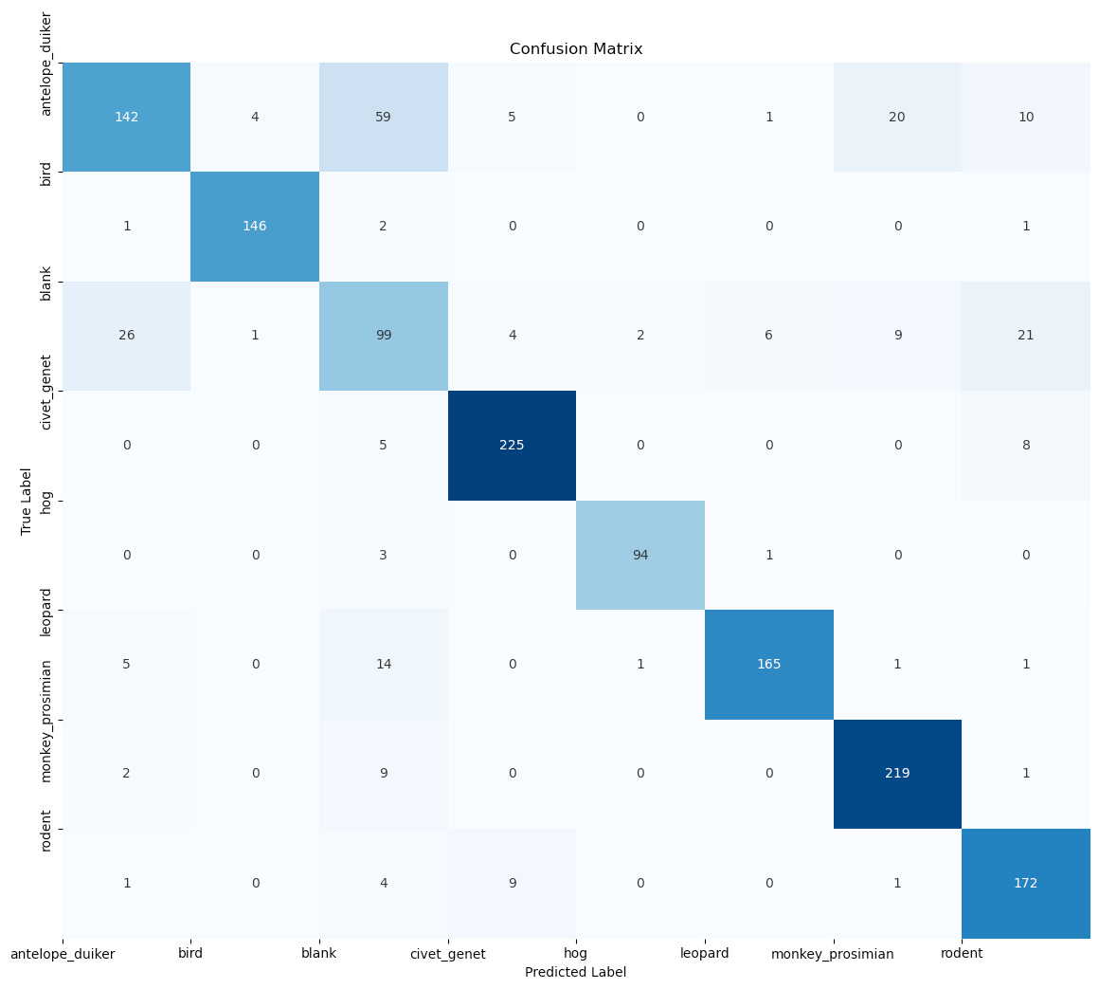
Model 2 Confusion Matrix (Holdout Set)

Slide 19
Model 2 Evaluation (Holdout Set)
 | precision | recall | f1-score | support
antelope_duiker | 0.8 | 0.59 | 0.68 | 241
bird | 0.97 | 0.97 | 0.97 | 150
blank | 0.51 | 0.59 | 0.55 | 168
civet_genet | 0.93 | 0.95 | 0.94 | 238
hog | 0.97 | 0.96 | 0.96 | 98
leopard | 0.95 | 0.88 | 0.92 | 187
monkey_prosimian | 0.88 | 0.95 | 0.91 | 231
rodent | 0.8 | 0.92 | 0.86 | 187
accuracy |  |  | 0.84 | 1500
macro avg | 0.85 | 0.85 | 0.85 | 1500
weighted avg | 0.85 | 0.84 | 0.84 | 1500

Slide 20
Model 2 Evaluation Metric (Holdout set) As per Competition
Log Loss: 5.718926337739923

Slide 21
Model 3
Using Transfer Learning from Image net, we use Model VGG16 containing 19 Layers.
Dense layer with 128 Neurons with “Relu” as activation function.
Another Layer with 128 Neurons with “Relu” as activation function.
Final Output layer is a Dense Layer with 8 Neurons and “Softmax” activation.

Slide 22
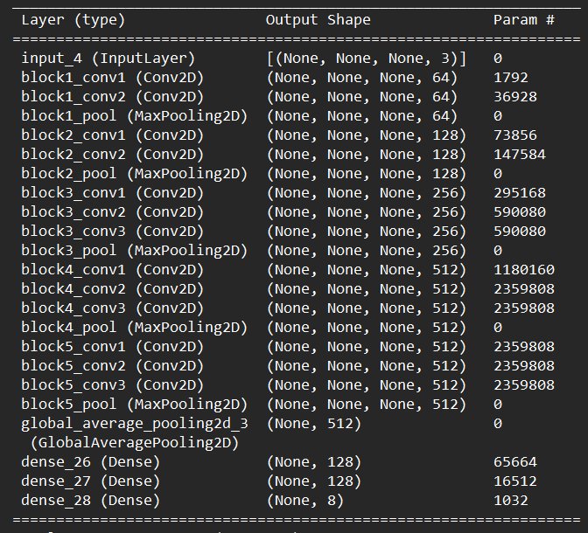
VGG16

Slide 23
Model 3 Training Performance
Epoch | loss | Train Accuracy | val_loss | val_accuracy
1/20 | 0.9799 | 0.636 | 1.0168 | 0.6263
2/20 | 0.952 | 0.6466 | 0.9589 | 0.6515
3/20 | 0.922 | 0.6615 | 1.0022 | 0.6448
4/20 | 0.8968 | 0.6724 | 0.9483 | 0.6574
5/20 | 0.8803 | 0.6806 | 0.9231 | 0.6696
6/20 | 0.8553 | 0.6868 | 0.9054 | 0.6793
7/20 | 0.8372 | 0.6917 | 0.9324 | 0.6626
8/20 | 0.8184 | 0.7031 | 0.8867 | 0.6759
9/20 | 0.8091 | 0.7017 | 0.927 | 0.6619
10/20 | 0.7805 | 0.7138 | 0.8801 | 0.6833
11/20 | 0.7694 | 0.7175 | 0.8674 | 0.6856
12/20 | 0.7583 | 0.7226 | 0.8499 | 0.7011
13/20 | 0.7558 | 0.7194 | 0.8393 | 0.7044
14/20 | 0.7308 | 0.7336 | 0.8546 | 0.6944
15/20 | 0.7178 | 0.7374 | 0.8113 | 0.7107
16/20 | 0.7018 | 0.7426 | 0.8036 | 0.717
17/20 | 0.6918 | 0.7468 | 0.7951 | 0.7152
18/20 | 0.6743 | 0.7537 | 0.8207 | 0.7163
19/20 | 0.67 | 0.7533 | 0.8125 | 0.7237
20/20 | 0.6631 | 0.7594 | 0.7688 | 0.72

Slide 24
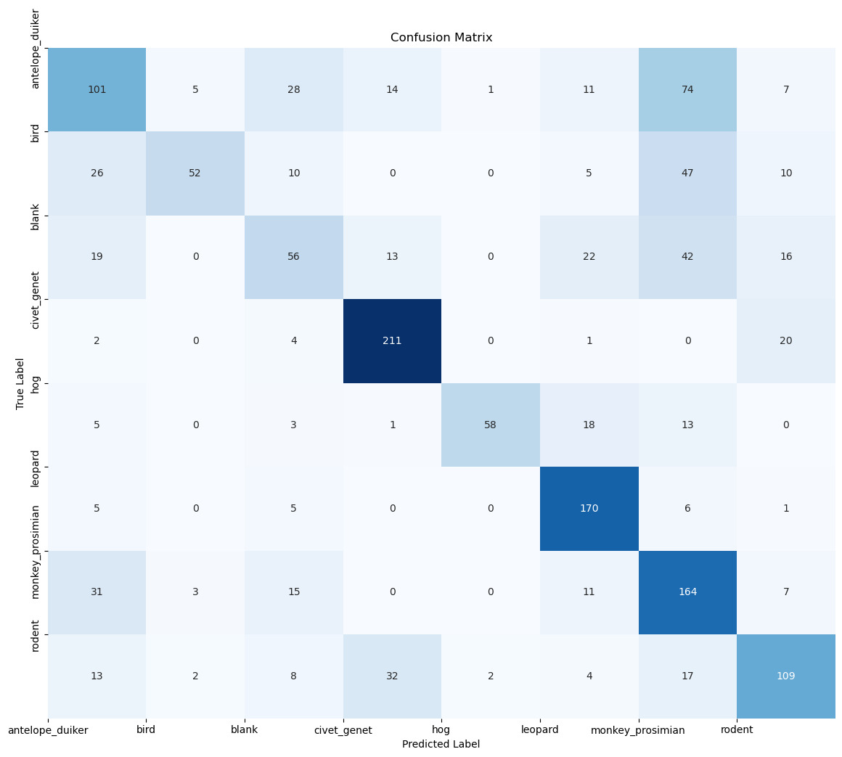
Model 3 Confusion Matrix (Holdout Set)

Slide 25
Model 3 Evaluation (Holdout Set)
 | precision | recall | f1-score | support
antelope_duiker | 0.5 | 0.42 | 0.46 | 241
bird | 0.84 | 0.35 | 0.49 | 150
blank | 0.43 | 0.33 | 0.38 | 168
civet_genet | 0.78 | 0.89 | 0.83 | 238
hog | 0.95 | 0.59 | 0.73 | 98
leopard | 0.7 | 0.91 | 0.79 | 187
monkey_prosimian | 0.45 | 0.71 | 0.55 | 231
rodent | 0.64 | 0.58 | 0.61 | 187
accuracy |  |  | 0.61 | 1500
macro avg | 0.66 | 0.6 | 0.6 | 1500
weighted avg | 0.64 | 0.61 | 0.6 | 1500

Slide 26
Model 3 Evaluation Metric (Holdout set) As per Competition
Log Loss: 13.912850208199224

Slide 27
Project Timeline
1 Nov.
Finalize methodology
15 Nov.
Next iterations of training
16 Nov – 3 Dec.
Refining of model
4 Dec .
Calculate accuracy on test set
8 Dec.
Presentation!

Slide 28
Team Roles
Aseem Mishra – Model Design and Training
Marttin Emmanuel – Testing and refining model
Sagar Sheth – Data Pre processing

Slide 29
Thank you

